Slide 1
Optimality Conditions for Smooth Optimization
IDS 435
Instructor: Selva Nadarajah

Slide 2
Discussion Plan
Onedimensional optimization
Multidimensional optimization

Slide 3
Onedimensional Optimization

Slide 4
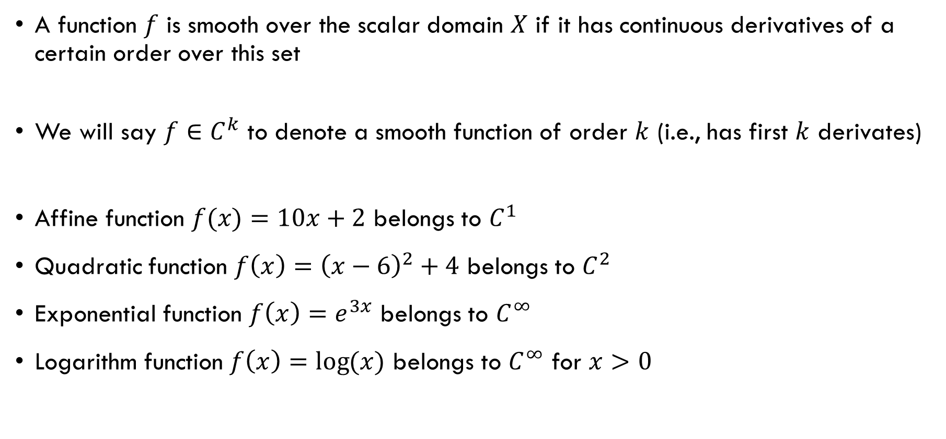
Smooth Function
A function $f$ is smooth over the scalar domain $X$ if it has continuous derivatives of a certain order over this set
We will say $f∈C^{k}$ to denote a smooth function of order $k$ (i.e., has first $k$ derivates)
Affine function $f(x)=10x+2$ belongs to $C^{1}$
Quadratic function $f\left(x\right)={\left(x−6\right)}^{2}+4$ belongs to $C^{2}$
Exponential function $f\left(x\right)=e^{3x}$ belongs to $C^{∞}$
Logarithm function $f\left(x\right)=\log{(x)}$ belongs to $C^{∞}$ for $x>0$

Slide 5
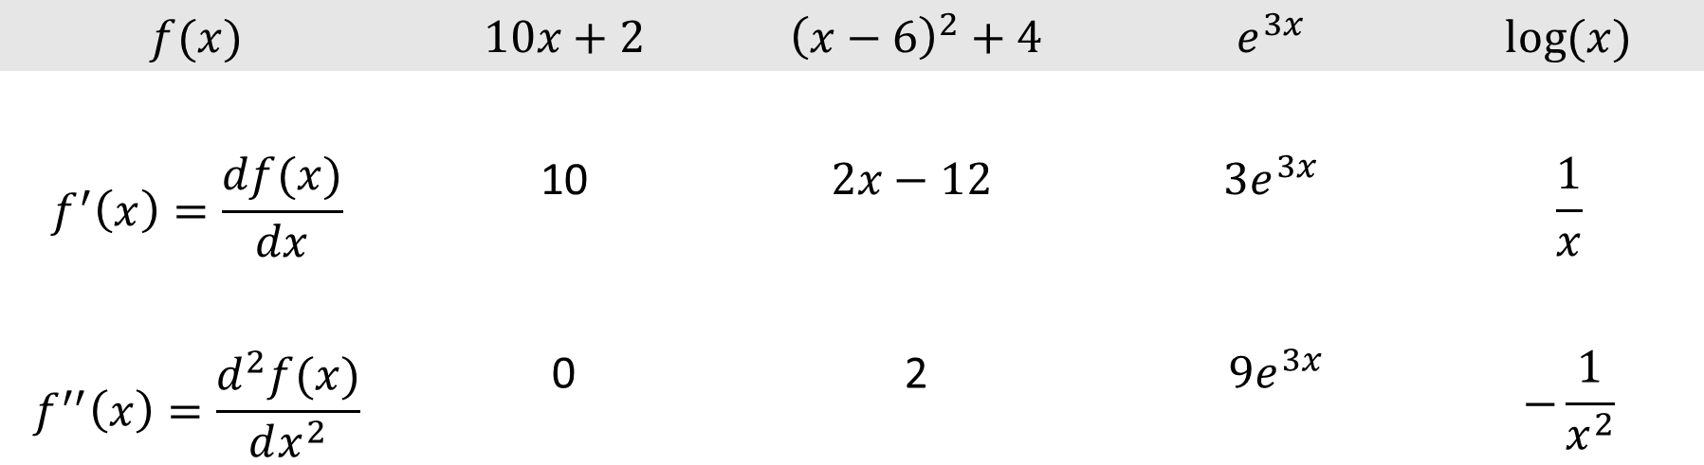
First and Second Derivatives
$$f(x)$$ | $10x+2$ | ${\left(x−6\right)}^{2}+4$ | $$e^{3x}$$ | $$\log{(x)}$$
$$f^{′}\left(x\right)=\frac{df(x)}{dx}$$ | 10 | $$2x−12$$ | $$3e^{3x}$$ | $$\frac{1}{x}$$
$$f^{′′}\left(x\right)=\frac{d^{2}f(x)}{dx^{2}}$$ | 0 | 2 | $$9e^{3x}$$ | $$−\frac{1}{x^{2}}$$

Slide 6
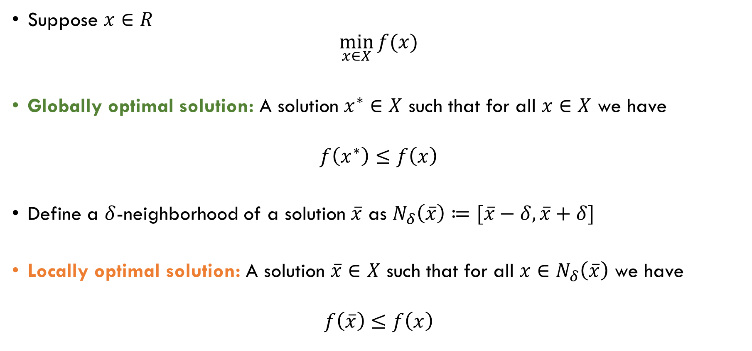
Notions of Optimality
Suppose $x∈R$
$$\min_{x∈X}{f(x)}$$
Globally optimal solution: A solution $x^{∗}∈X$ such that for all $x∈X$ we have
$$f\left(x^{∗}\right)≤f\left(x\right)$$
Define a $δ$-neighborhood of a solution $\overline{x}$ as $N_{δ}\left(\overline{x}\right)≔[\overline{x}−δ,\overline{x}+δ]$
Locally optimal solution: A solution $\overline{x}∈X$ such that for all $x∈N_{δ}\left(\overline{x}\right)$ we have
$$f\left(\overline{x}\right)≤f\left(x\right)$$

Slide 7
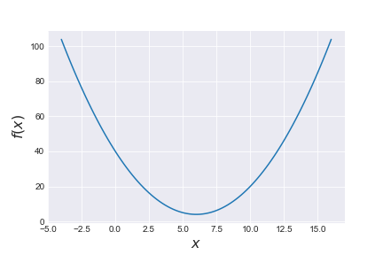

Quadratic Function Example
$$f\left(x\right)={\left(x−6\right)}^{2}+4$$
Is $x=6$ locally optimal?
Yes, because
$$f\left(6\right)=4≤f\left(x\right), ∀x∈N_{1}(6)$$
Is $x=6$ globally optimal?
Yes, because
$f\left(6\right)=4≤f\left(x\right), ∀x∈X$

Slide 8
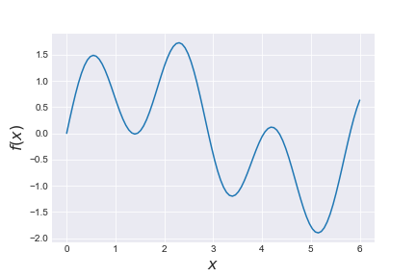

Sinusoidal Function Example
$$f\left(x\right)=\sin\left(x\right)+\sin{(10x/3)}$$
Is $x=1.397$ locally optimal?
Yes, because
$f\left(1.397\right)=−0.013520$
$$≤f\left(x\right), ∀x∈N_{0.5}(1.397)$$
Is $x=1.397$ globally optimal?
No, because
$f\left(5.147\right)=−1.899≤f\left(1.397\right)$

Slide 9
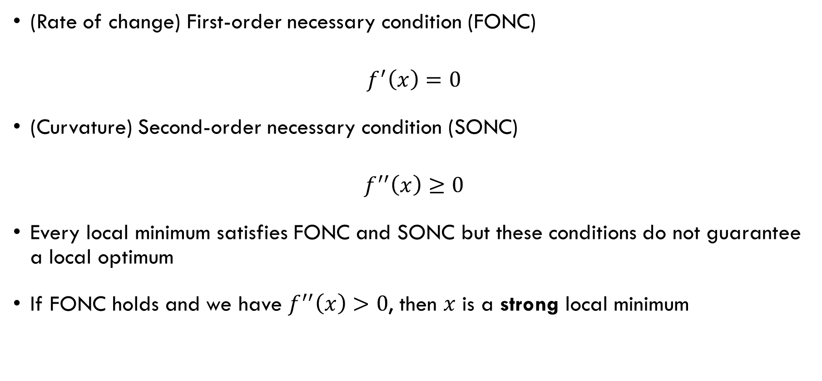
Conditions for Local Minimum
(Rate of change) First-order necessary condition (FONC)
$$f^{′}\left(x\right)=0$$
(Curvature) Second-order necessary condition (SONC)
$$f^{′′}\left(x\right)≥0$$
Every local minimum satisfies FONC and SONC but these conditions do not guarantee a local optimum
If FONC holds and we have $f^{′′}\left(x\right)>0$, then $x$ is a strong local minimum

Slide 10

Quadratic Function Example
$$f\left(x\right)={\left(x−6\right)}^{2}+4$$
Is $x=6$ locally optimal?
FONC:
$$f^{′}\left(x\right)=2x−12$$
$$f^{′}\left(6\right)=0$$
SONC:
$$f^{′′}\left(x\right)=2>0$$
Yes, it is a strong local minimum

Slide 11

Sinusoidal Function Example
Is $x=5.147$ locally optimal?
FONC:
$$f^{′}\left(x\right)=\cos{(x)}+\frac{10}{3}\cos{(10x/3)}$$
$$f^{′}\left(5.147\right)≈0$$
SONC:
$$f^{′′}\left(x\right)=−\sin\left(x\right)−\frac{100}{9}\sin{(10x/3)}$$
$$f^{′′}\left(5.147\right)≈11.94>0$$
Yes!
$$f\left(x\right)=\sin\left(x\right)+\sin{(10x/3)}$$

Slide 12
Multidimensional Optimization

Slide 13

Smooth Function
A multi-dimensional function $f$ is smooth over the domain $X$ if all its partial derivatives are continuous over this set
We will say $f∈C^{k}$ to denote a smooth function of order $k$ (i.e., has first $k$ partial derivates)

Slide 14

Column and Row Vectors
An $n$-dimensional column vector
$$\left(\begin{matrix}x_{1} \\ x_{2} \\ ⋮ \\ x_{n}\end{matrix}\right)$$
An $n$-dimensional column vector $(x_{1},x_{2},…,x_{n})$
Transpose of a column vector is a row vector and vice versa
Transpose of a $m×n$ matrix is an $n×m$ matrix

Slide 15

Norm
Norms are measures of “distance”
Two-norm: ${\left\|x\right\|}_{2}=\sqrt{\sum_{i=1}^{n}{x_{i}^{2}}}$
One-norm: ${\left\|x\right\|}_{1}=\sum_{i=1}^{n}{\left|x_{i}\right|}$
Example (3-dimensional): $x=(1,−3,1)$
${\left\|x\right\|}_{2}=\sqrt{\sum_{i=1}^{n}{x_{i}^{2}}}=\sqrt{1^{2}+{(−3)}^{2}+1^{1}}=\sqrt{11}$
${\left\|x\right\|}_{1}=\sum_{i=1}^{n}{\left|x_{i}\right|}= \left|1\right|+\left|−3\right|+\left|1\right|=5$

Slide 16

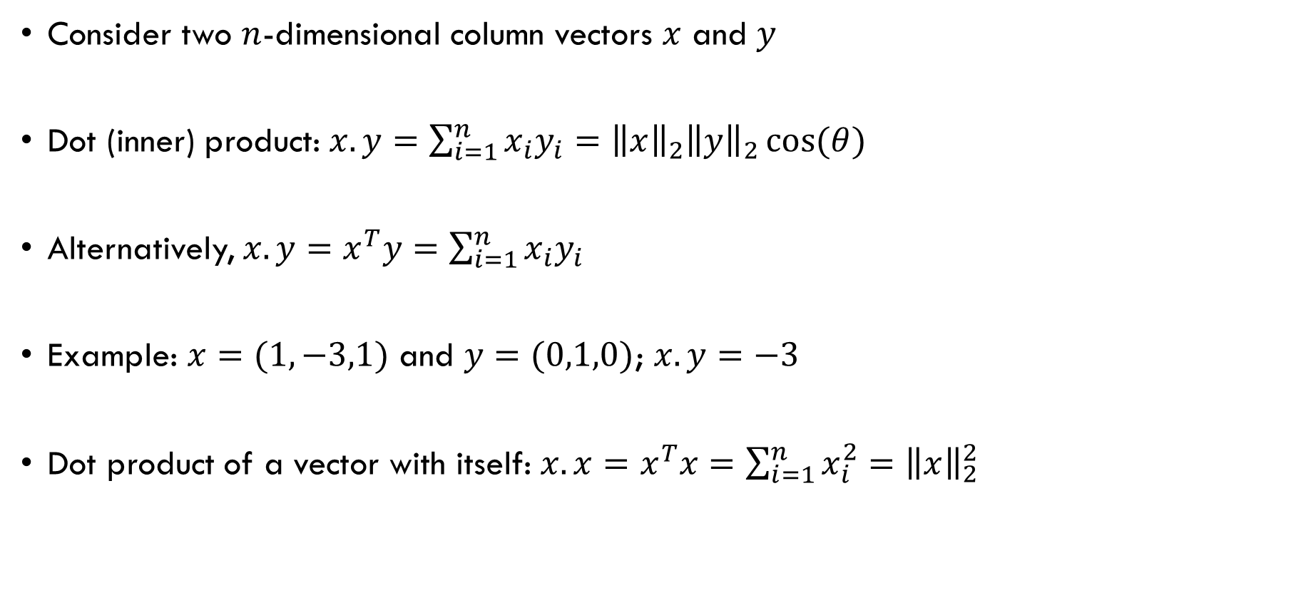


Dot Product
Consider two $n$-dimensional column vectors $x$ and $y$
Dot (inner) product: $x.y=\sum_{i=1}^{n}{x_{i}y_{i}}={\left\|x\right\|}_{2}{\left\|y\right\|}_{2}\cos{(θ)}$
Alternatively, $x.y=x^{T}y=\sum_{i=1}^{n}{x_{i}y_{i}}$
Example: $x=(1,−3,1)$ and $y=(0,1,0)$; $x.y=−3$
Dot product of a vector with itself: $x.x=x^{T}x=$ $\sum_{i=1}^{n}{x_{i}^{2}}={\left\|x\right\|}_{2}^{2}$
$$x$$
$$θ$$
$$y$$

Slide 17
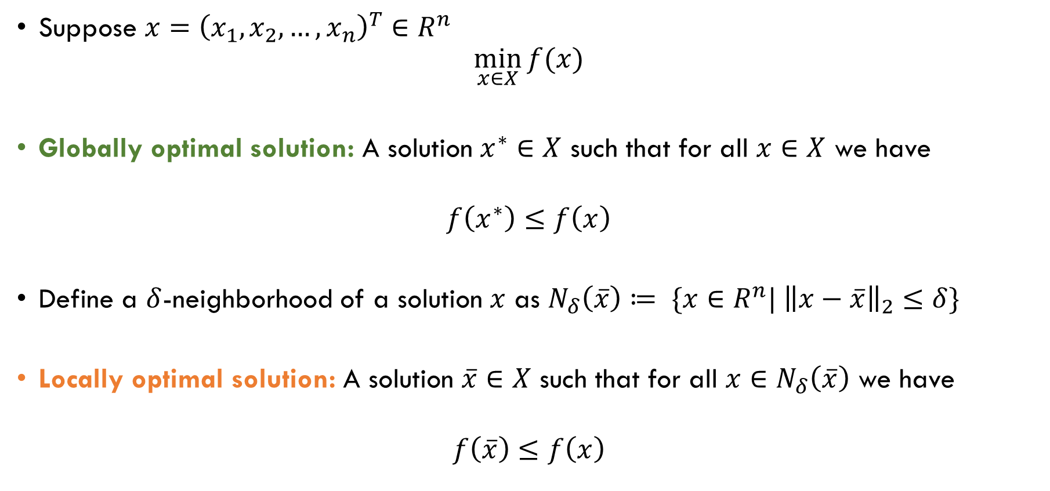
Notions of Optimality
Suppose $x={\left(x_{1},x_{2},…,x_{n}\right)}^{T}∈R^{n}$
$$\min_{x∈X}{f(x)}$$
Globally optimal solution: A solution $x^{∗}∈X$ such that for all $x∈X$ we have
$$f\left(x^{∗}\right)≤f\left(x\right)$$
Define a $δ$-neighborhood of a solution $x$ as $N_{δ}\left(\overline{x}\right)≔ \{x∈R^{n}| {\left\|x−\overline{x}\right\|}_{2}≤δ\}$
Locally optimal solution: A solution $\overline{x}∈X$ such that for all $x∈N_{δ}\left(\overline{x}\right)$ we have
$$f\left(\overline{x}\right)≤f\left(x\right)$$

Slide 18

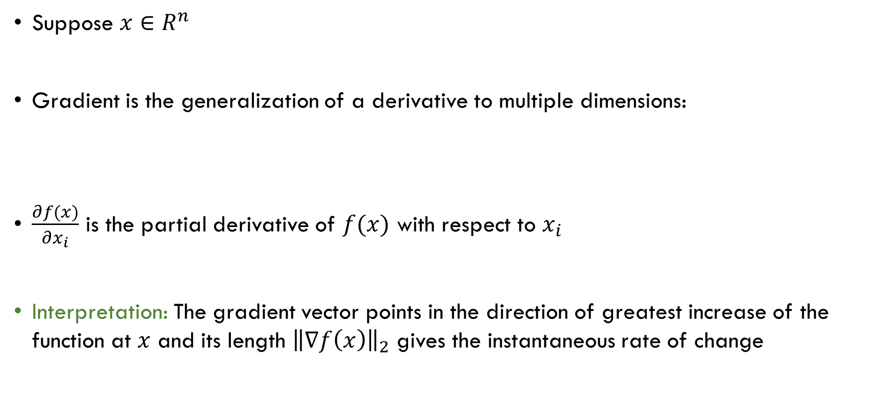
Gradient
$$∇f\left(x\right)=\left[\begin{aligned}\frac{∂f(x)}{∂x_{1}} \\ \frac{∂f(x)}{∂x_{2}} \\ ⋮ \\ \frac{∂f(x)}{∂x_{n}}\end{aligned}\right]$$
Suppose $x∈R^{n}$
Gradient is the generalization of a derivative to multiple dimensions:
$\frac{∂f(x)}{∂x_{i}}$ is the partial derivative of $f(x)$ with respect to $x_{i}$
Interpretation: The gradient vector points in the direction of greatest increase of the function at $x$ and its length ${\left\|∇f\left(x\right)\right\|}_{2}$ gives the instantaneous rate of change

Slide 19
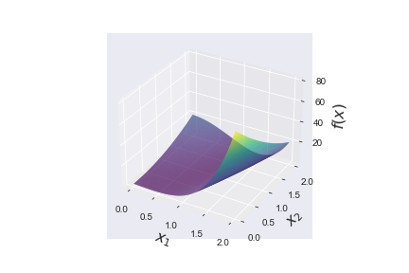

Example: Rosenbrock Banana Function
$$f\left(x\right)={\left(1−x_{1}\right)}^{2}+5{\left(x_{2}−x_{1}^{2}\right)}^{2}$$

Slide 20

Example: Rosenbrock Banana Function
$$f\left(x\right)={\left(1−x_{1}\right)}^{2}+5{\left(x_{2}−x_{1}^{2}\right)}^{2}$$
$$\frac{∂f(x)}{∂x_{1}}=2\left(10x_{1}^{3}−10x_{1}x_{2}+x_{1}−1\right)$$
$$\frac{∂f(x)}{∂x_{2}}=10\left(x_{2}−x_{1}^{2}\right)$$
$$∇f\left(0,1\right)=\left[\begin{aligned}−2 \\ 10\end{aligned}\right]$$
$${\left\|∇f\left(0,1\right)\right\|}_{2}=\sqrt{{\left(−2\right)}^{2}+{\left(10\right)}^{2}}≈10.2$$

Slide 21
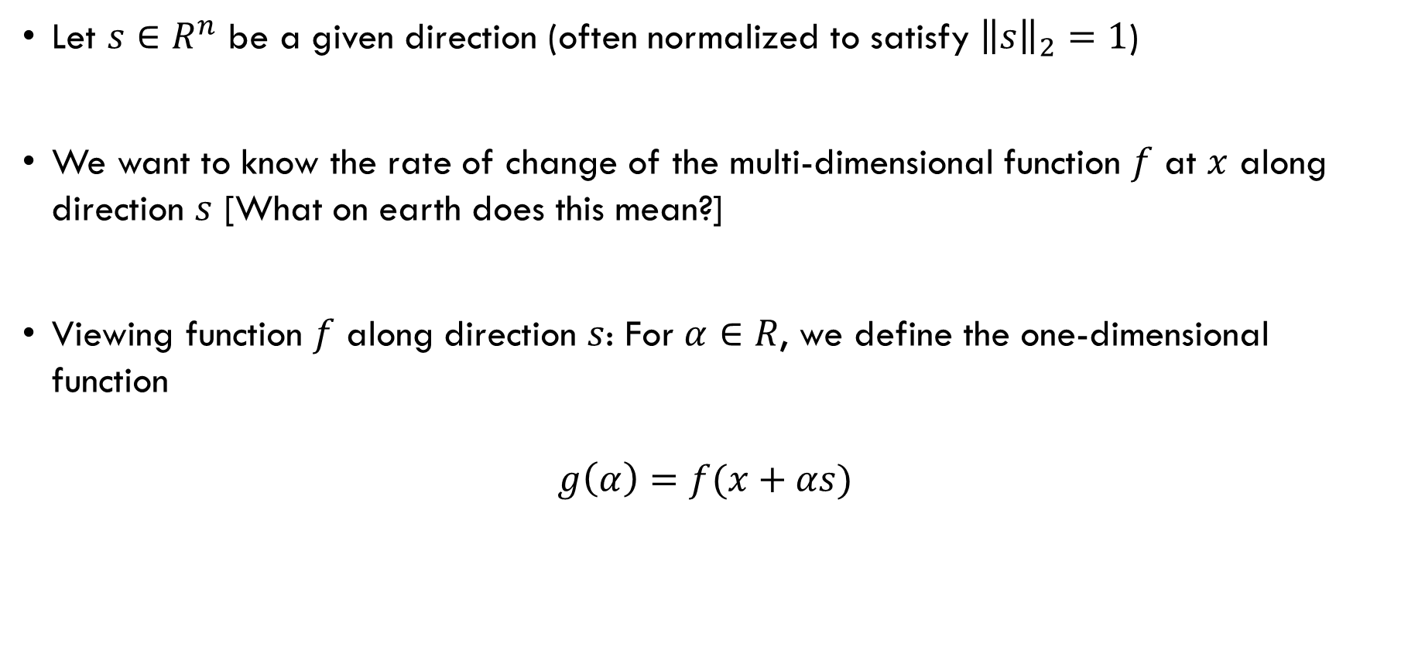
Behavior of a Function Along a Direction
Let $s∈R^{n}$ be a given direction (often normalized to satisfy ${\left\|s\right\|}_{2}=1$)
We want to know the rate of change of the multi-dimensional function $f$ at $x$ along direction $s$ [What on earth does this mean?]
Viewing function $f$ along direction $s$: For $α∈R$, we define the one-dimensional function
$$g\left(α\right)=f(x+αs)$$

Slide 22
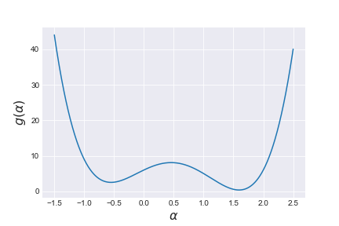

Example: Rosenbrock Banana Function
View of function at $x=(0,1)$ along the direction $s=\left(1,1\right)$
$$g\left(α\right)={\left(1−α\right)}^{2}+5{\left(1+α−α^{2}\right)}^{2}$$

Slide 23

Directional Derivative
Derivative of $g(α)$
$$g^{′}(α)=∇f{\left(x+αs\right)}^{T}s$$
The rate of change of the multi-dimensional function $f$ at $x$ along direction $s$
$${∇_{s}f\left(x\right)=g}^{′}(0)=∇f{\left(x\right)}^{T}s$$

Slide 24
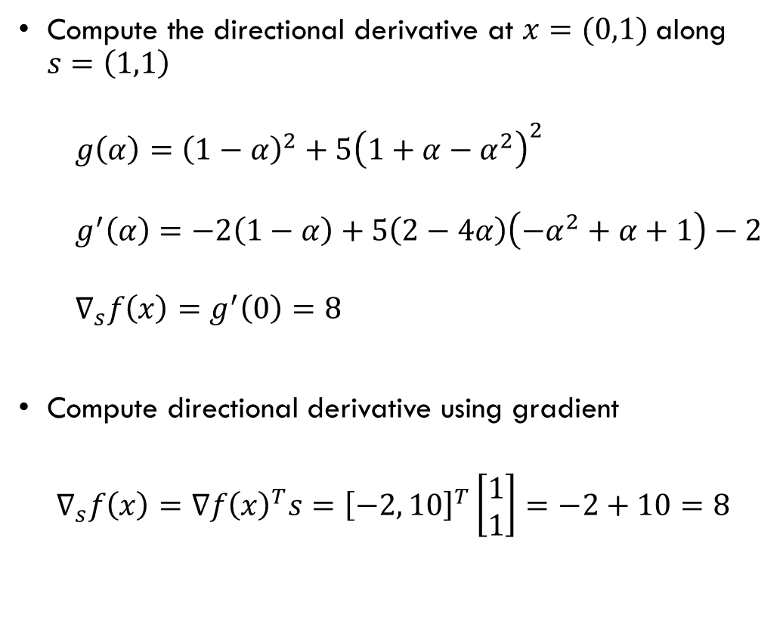
Example: Rosenbrock Banana Function
Compute the directional derivative at $x=(0,1)$along $s=\left(1,1\right)$
$g\left(α\right)={\left(1−α\right)}^{2}+5{\left(1+α−α^{2}\right)}^{2}$
$$g^{′}\left(α\right)=−2\left(1−α\right)+5\left(2−4α\right)\left(−α^{2}+α+1\right)−2$$
$$∇_{s}f\left(x\right)=g^{′}\left(0\right)=8$$
Compute directional derivative using gradient
$$∇_{s}f\left(x\right)=∇f{\left(x\right)}^{T}s={\left[−2, 10\right]}^{T}\left[\begin{matrix}1 \\ 1\end{matrix}\right]=−2+10=8$$
Does this value make sense?

Slide 25

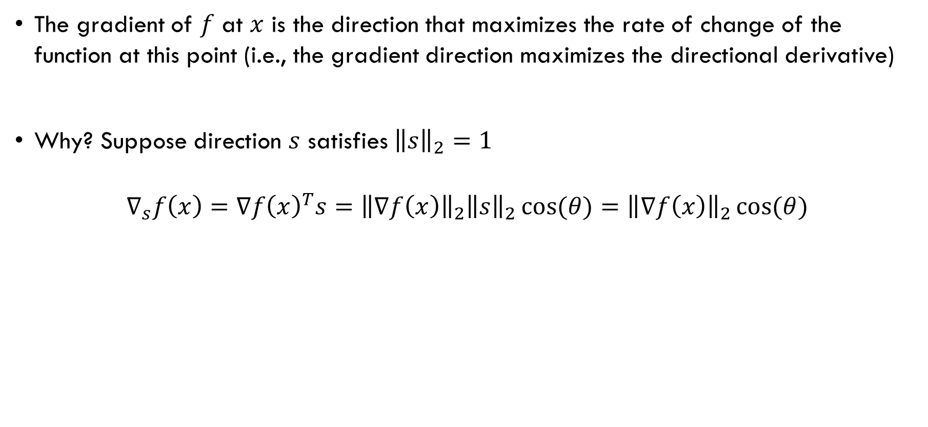



Gradient Interpretation
The gradient of $f$ at $x$ is the direction that maximizes the rate of change of the function at this point (i.e., the gradient direction maximizes the directional derivative)
Why? Suppose direction $s$ satisfies ${\left\|s\right\|}_{2}=1$
$$∇_{s}f\left(x\right)=∇f{\left(x\right)}^{T}s={\left\|∇f\left(x\right)\right\|}_{2}{\left\|s\right\|}_{2}\cos{(θ)}={\left\|∇f\left(x\right)\right\|}_{2}\cos{(θ)}$$
Takeaway:
$\cos{(θ)}$ has a maximum value of 1 at $θ=0$, which is when $s$ is in the same direction as $∇f$
$$∇f$$
$$θ$$
$$s$$

Slide 26

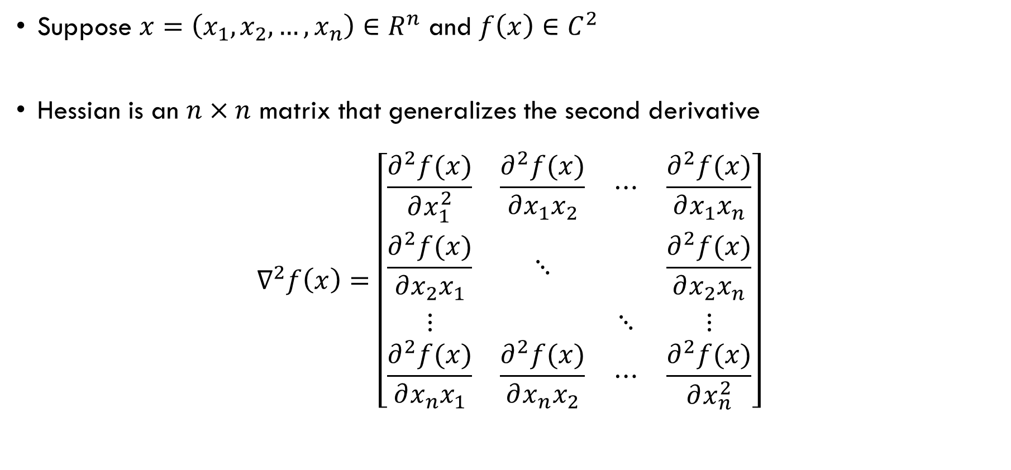
Hessian
Suppose $x=\left(x_{1},x_{2},…,x_{n}\right)∈R^{n}$ and $f\left(x\right)∈C^{2}$
Hessian is an $n×n$ matrix that generalizes the second derivative
$$∇^{2}f\left(x\right)=\left[\begin{matrix}\frac{∂^{2}f(x)}{∂x_{1}^{2}} & \frac{∂^{2}f(x)}{∂x_{1}x_{2}} & ⋯ & \frac{∂^{2}f(x)}{∂x_{1}x_{n}} \\ \frac{∂^{2}f(x)}{∂x_{2}x_{1}} & ⋱ & & \frac{∂^{2}f(x)}{∂x_{2}x_{n}} \\ ⋮ & & ⋱ & ⋮ \\ \frac{∂^{2}f(x)}{∂x_{n}x_{1}} & \frac{∂^{2}f(x)}{∂x_{n}x_{2}} & ⋯ & \frac{∂^{2}f(x)}{∂x_{n}^{2}}\end{matrix}\right]$$

Slide 27







Example: Rosenbrock Banana Function
$$f\left(x\right)={\left(1−x_{1}\right)}^{2}+5{\left(x_{2}−x_{1}^{2}\right)}^{2}$$
$$\frac{∂^{2}f(x)}{∂x_{1}^{2}}$$
$$\frac{∂^{2}f(x)}{∂x_{1}x_{2}}$$
$$∇f\left(x\right)=\left[\begin{matrix}2\left(10x_{1}^{3}−10x_{1}x_{2}+x_{1}−1\right) \\ 10\left(x_{2}−x_{1}^{2}\right)\end{matrix}\right]$$
$$∇f\left(0,1\right)=\left[\begin{aligned}−2 \\ 10\end{aligned}\right]$$
$$∇^{2}f\left(x\right)=\left[\begin{matrix}2(30x_{1}^{2}−10x_{2}+1) & −20x_{1} \\ −20x_{1} & 10\end{matrix}\right]$$
$$∇^{2}f\left(0,1\right)=\left[\begin{matrix}−18 & 0 \\ 0 & 10\end{matrix}\right]$$
$$\frac{∂^{2}f(x)}{∂x_{2}x_{1}}$$
$$\frac{∂^{2}f(x)}{∂x_{2}^{2}}$$

Slide 28
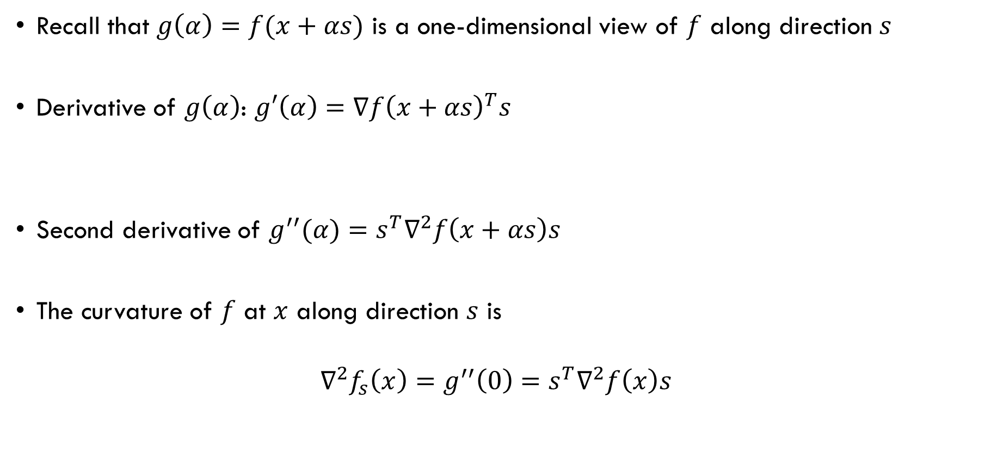
Curvature of $g(α)$
Recall that $g\left(α\right)=f(x+αs)$ is a one-dimensional view of $f$ along direction $s$
Derivative of $g\left(α\right)$: $g′\left(α\right)=∇f{\left(x+αs\right)}^{T}s$
Second derivative of $g^{′′}(α)=s^{T}∇^{2}f\left(x+αs\right)s$
The curvature of $f$ at $x$ along direction $s$ is
$$∇^{2}f_{s}\left(x\right)=g^{′′}\left(0\right)=s^{T}∇^{2}f\left(x\right)s$$

Slide 29
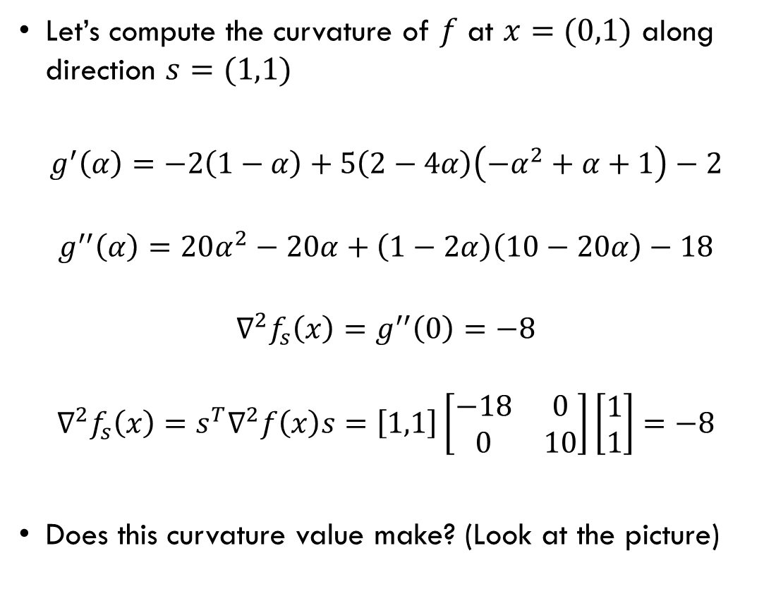
Example: Rosenbrock Banana Function
Let’s compute the curvature of $f$ at $x=(0,1)$ along direction $s=(1,1)$
$$g^{′}\left(α\right)=−2\left(1−α\right)+5\left(2−4α\right)\left(−α^{2}+α+1\right)−2$$
$$g^{′′}\left(α\right)=20α^{2}−20α+\left(1−2α\right)\left(10−20α\right)−18$$
$$∇^{2}f_{s}\left(x\right)=g^{′′}\left(0\right)=−8$$
$$∇^{2}f_{s}\left(x\right)=s^{T}∇^{2}f\left(x\right)s=\left[1,1\right]\left[\begin{matrix}−18 & 0 \\ 0 & 10\end{matrix}\right]\left[\begin{matrix}1 \\ 1\end{matrix}\right]=−8$$
Does this curvature value make? (Look at the picture)

Slide 30
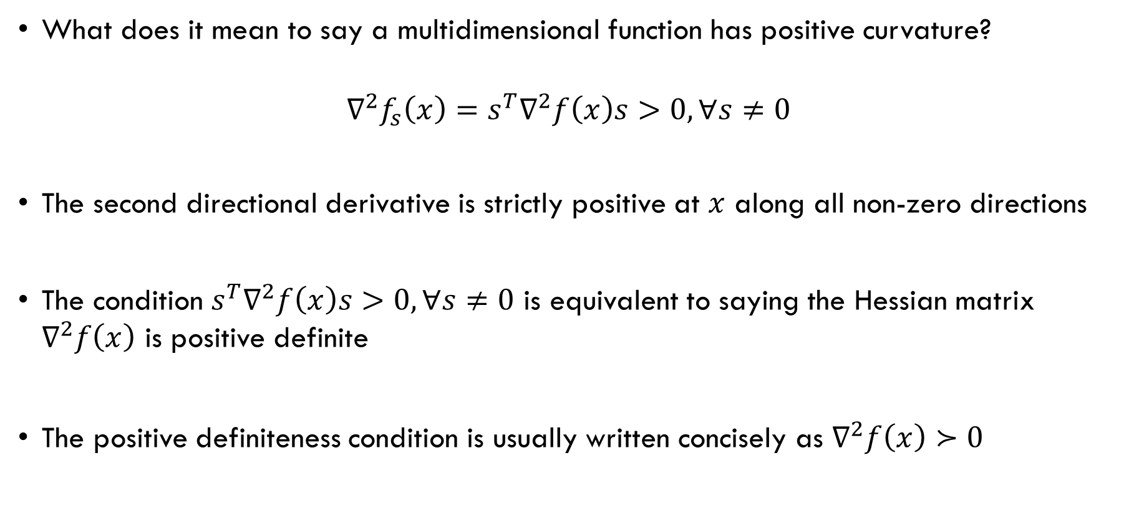
Positive Curvature of $f$
What does it mean to say a multidimensional function has positive curvature?
$$∇^{2}f_{s}\left(x\right)=s^{T}∇^{2}f\left(x\right)s>0, ∀s≠0$$
The second directional derivative is strictly positive at $x$ along all non-zero directions
The condition $s^{T}∇^{2}f\left(x\right)s>0, ∀s≠0$ is equivalent to saying the Hessian matrix $∇^{2}f\left(x\right)$ is positive definite
The positive definiteness condition is usually written concisely as $∇^{2}f\left(x\right)≻0$

Slide 31
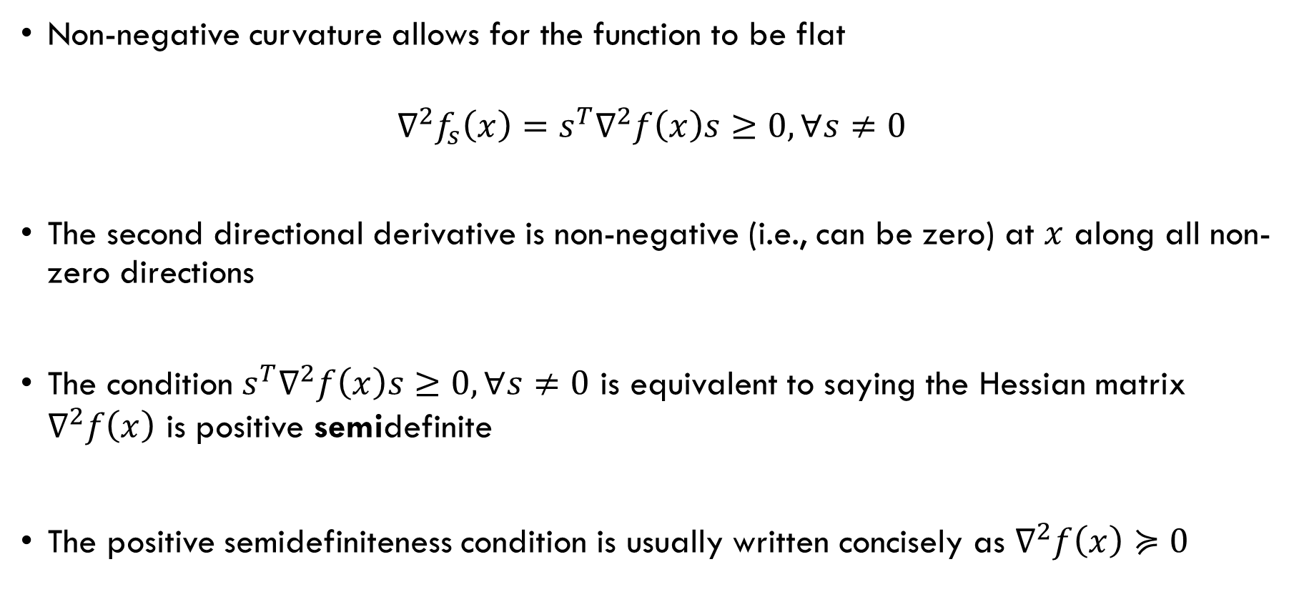
Nonnegative Curvature of $f$
Non-negative curvature allows for the function to be flat
$$∇^{2}f_{s}\left(x\right)=s^{T}∇^{2}f\left(x\right)s≥0, ∀s≠0$$
The second directional derivative is non-negative (i.e., can be zero) at $x$ along all non-zero directions
The condition $s^{T}∇^{2}f\left(x\right)s≥0, ∀s≠0$ is equivalent to saying the Hessian matrix $∇^{2}f\left(x\right)$ is positive semidefinite
The positive semidefiniteness condition is usually written concisely as $∇^{2}f\left(x\right)≽0$

Slide 32
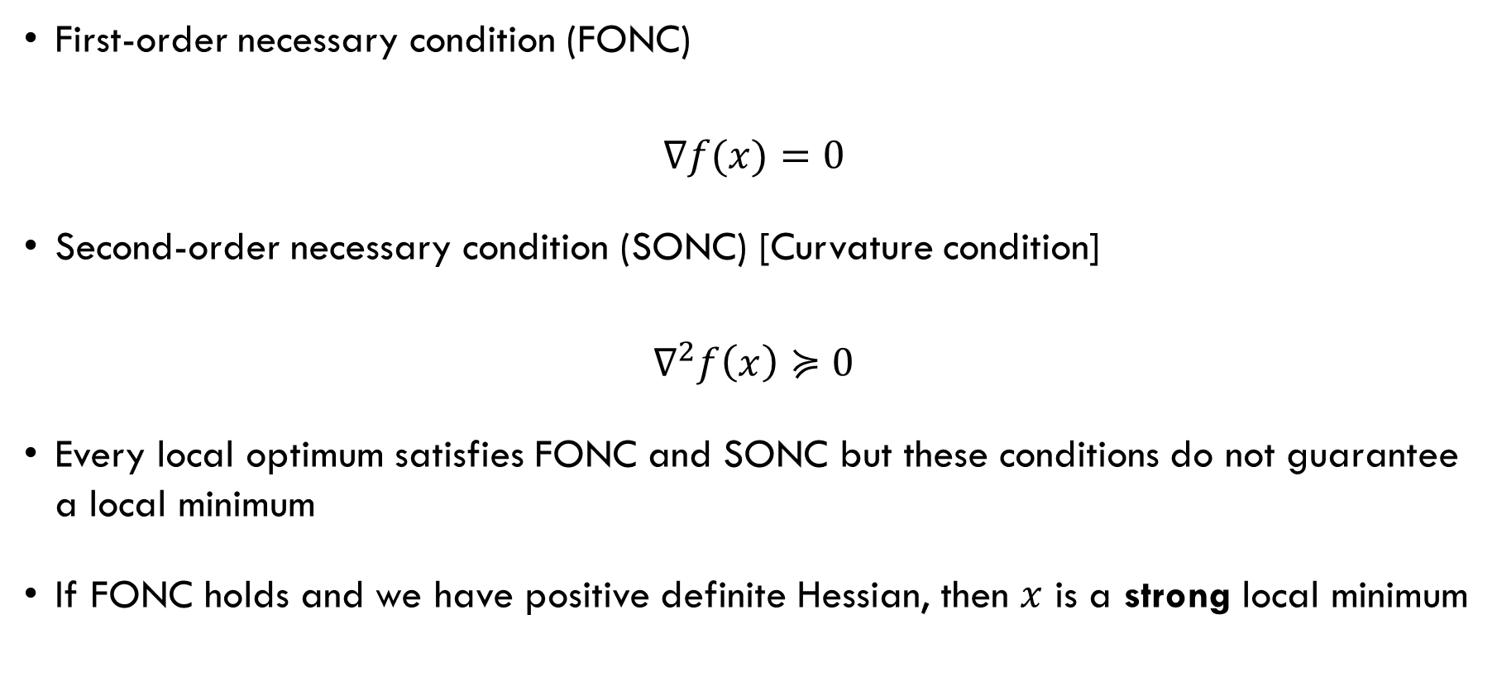
Conditions for Local Minimum
First-order necessary condition (FONC)
$$∇f(x)=0$$
Second-order necessary condition (SONC) [Curvature condition]
$$∇^{2}f\left(x\right)≽0$$
Every local optimum satisfies FONC and SONC but these conditions do not guarantee a local minimum
If FONC holds and we have positive definite Hessian, then $x$ is a strong local minimum
[max rate of change equals zero!]
[non-Negative curvature along all non-zero directions!]

Slide 33
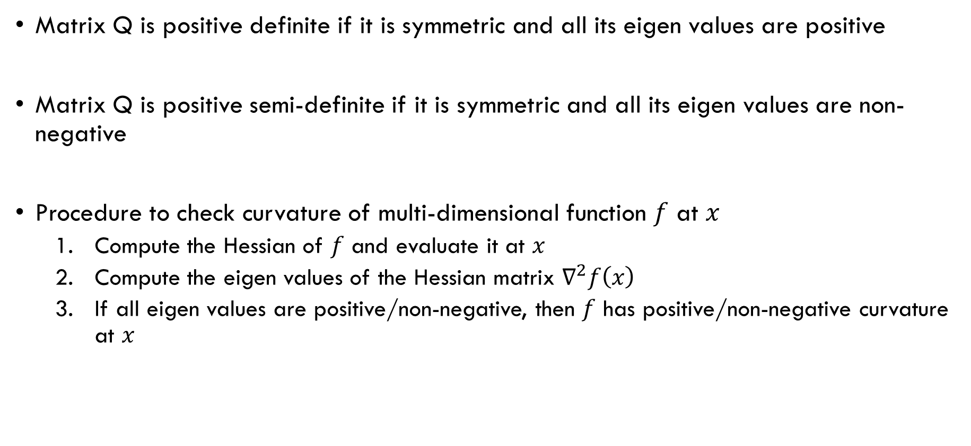
Checking Definiteness
Matrix Q is positive definite if it is symmetric and all its eigen values are positive
Matrix Q is positive semi-definite if it is symmetric and all its eigen values are non-negative
Procedure to check curvature of multi-dimensional function $f$ at $x$
Compute the Hessian of $f$ and evaluate it at $x$
Compute the eigen values of the Hessian matrix $∇^{2}f\left(x\right)$
If all eigen values are positive/non-negative, then $f$ has positive/non-negative curvature at $x$

Slide 34
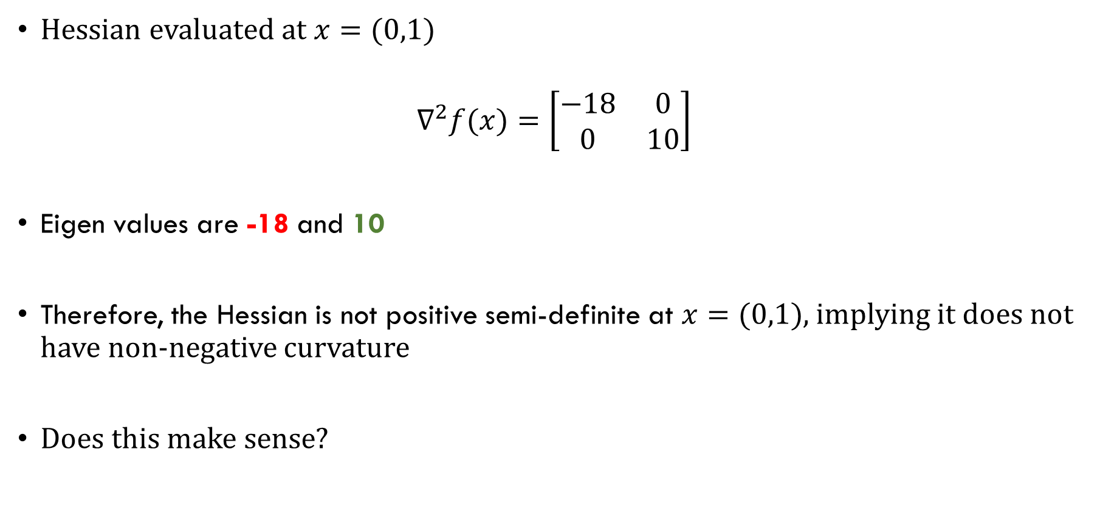
Example: Rosenbrock Banana Function
Hessian evaluated at $x=(0,1)$
$$∇^{2}f(x)=\left[\begin{matrix}−18 & 0 \\ 0 & 10\end{matrix}\right]$$
Eigen values are -18 and 10
Therefore, the Hessian is not positive semi-definite at $x=(0,1)$, implying it does not have non-negative curvature
Does this make sense?

Slide 35
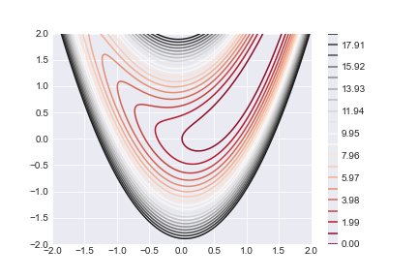
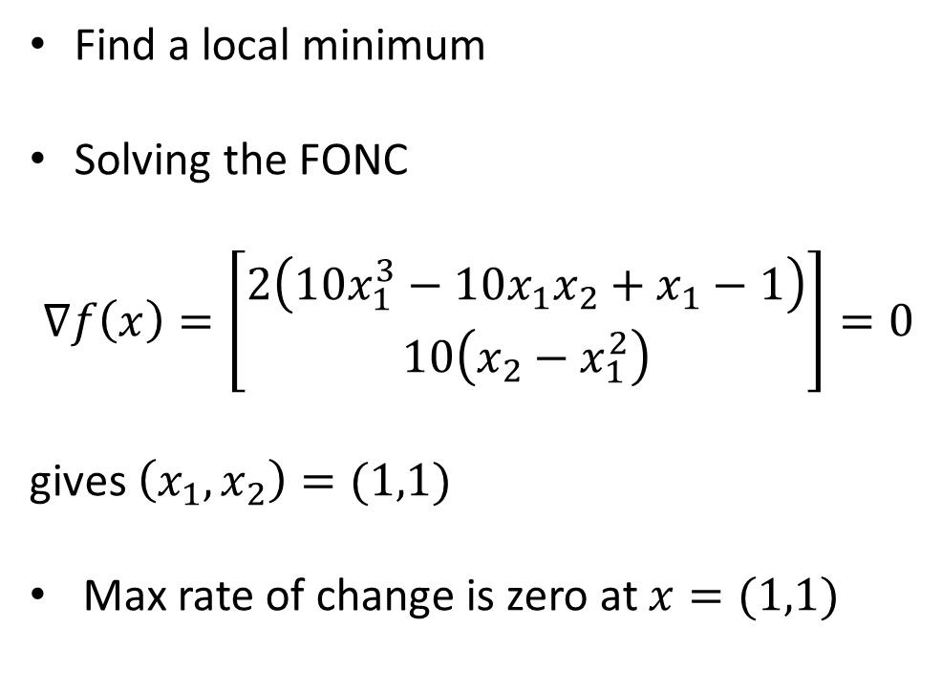
Example: Rosenbrock Banana Function
Find a local minimum
Solving the FONC
$$∇f\left(x\right)=\left[\begin{aligned}2\left(10x_{1}^{3}−10x_{1}x_{2}+x_{1}−1\right) \\ 10\left(x_{2}−x_{1}^{2}\right)\end{aligned}\right]=0$$
gives $\left(x_{1},x_{2}\right)=(1,1)$
Max rate of change is zero at $x=(1,1)$

Slide 36
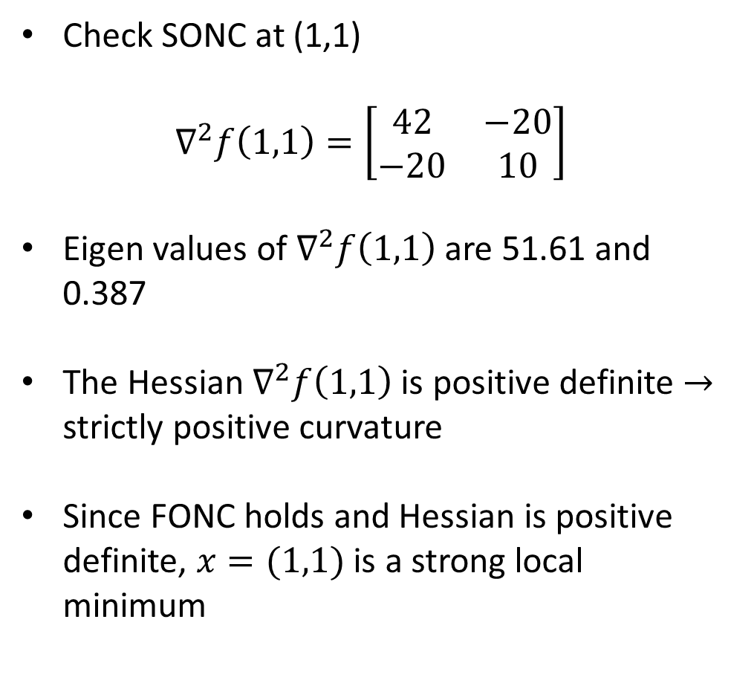
Example: Rosenbrock Banana Function
Check SONC at (1,1)
$$∇^{2}f\left(1,1\right)=\left[\begin{matrix}42 & −20 \\ −20 & 10\end{matrix}\right]$$
Eigen values of $∇^{2}f\left(1,1\right)$ are 51.61 and 0.387
The Hessian $∇^{2}f\left(1,1\right)$ is positive definite $→$ strictly positive curvature
Since FONC holds and Hessian is positive definite, $x=(1,1)$ is a strong local minimum

Slide 37
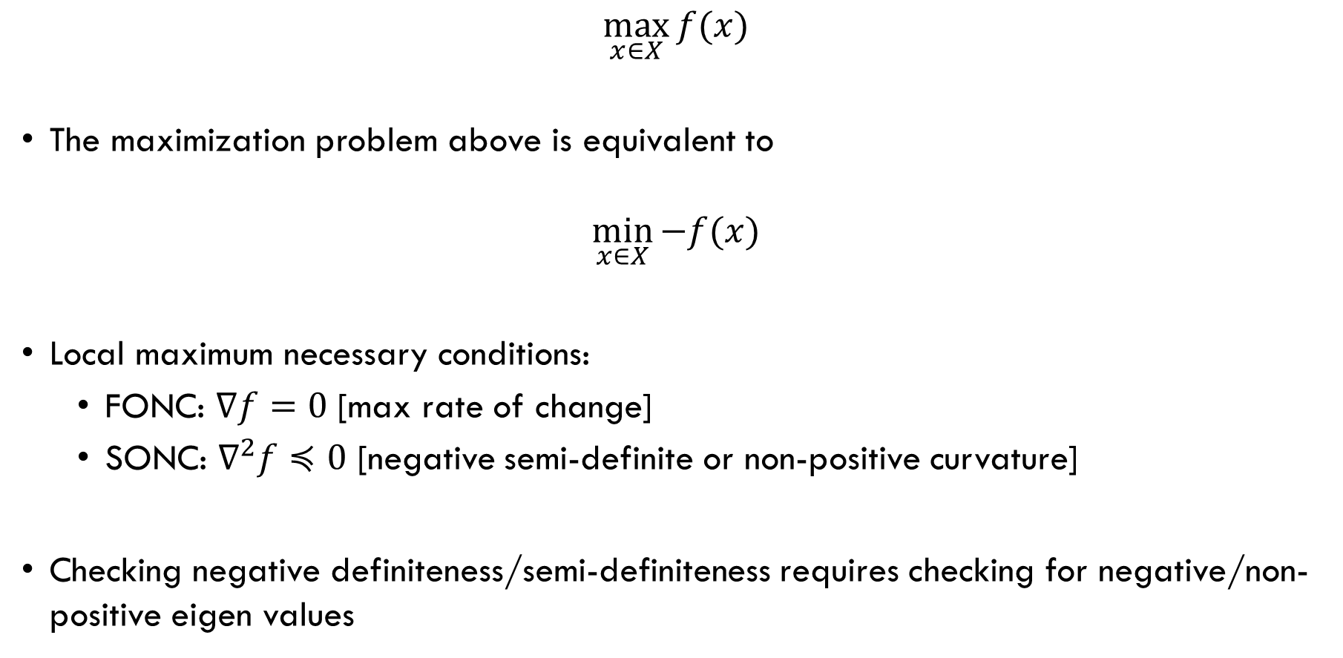
Maximization
$$\max_{x∈X}{f(x)}$$
The maximization problem above is equivalent to
$$\min_{x∈X}{−f(x)}$$
Local maximum necessary conditions:
FONC: $∇f=0$ [max rate of change]
SONC: $∇^{2}f≼0$ [negative semi-definite or non-positive curvature]
Checking negative definiteness/semi-definiteness requires checking for negative/non-positive eigen values

